Slide 1

GAMA Foundation
LIFELONG LEARNING PROGRAMME
LEONARDO LEARNING PARTNERSHIPS
Project’s title: CULINARY BRIDGES ACROSS EUROPE
FIRST WORKING MEETING IN THESSALONIKI, GREECE
NOVEMBER 2013

Slide 2

foundation`s staff
PRESIDENT:
Andrzej Kamliński.
I work as a manager of Occupational Therapy Workshops . I actively work and cooperate with local NGO`s . I repeatedly implemented and co-ordinated national and international projects co-financed from the European Social Fund, the European Commission, for example, Grundtvig Partnerships. Because of my training and experience I am responsible for personnel policy, contacts with individual employees and the general supervision of the activities of the group and financial documents of the Foundation.

Slide 3
foundation staff
VICE-PRESIDENT
Aneta Fiećko – Luty
At present she work as an instructor in Occupational Therapy Workshop . He has experience in organizing courses, events , charity auction aimed at social integration as well as cultivating tradition. She also participated in the implementation of projects co-financed by the ESF. Because of the education, experience, skills and abilities is responsible for raising funds and coordinating projects, contacts with sponsors and creating the image of the Foundation.

Slide 4
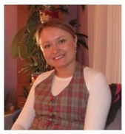
foundation staff
VICE-PRESIDENT
Joanna Świetlińska
She is a teacher of mathematics. Because of the qualifications she is responsible for financial matters - reports, invoices, oversight of financial operations.

Slide 5
GAMA Foundation's goals
GAMA Foundation was founded in 2008. According to the statute GAMA Foundation is to support civil society, in particular people with disabilities and at risk of social exclusion, as well as initiating and supporting solutions in various areas of social life, in particular the protection of the rights and freedoms of citizens, the protection of family and education, prevention and social integration.

Slide 6
GAMA Foundation's goals
At present, most attention focused within the broader education both vocational and social as well. We carry out projects aimed at children, youth and seniors. In our city Foundation established the Third Age University and Children`s University. Support also embrace people with disabilities to take care of their integration and contact with culture and art. The projects also relate to vocational training, such as culinary courses and workshops and ICT courses.

Slide 7
Our efforts are directed to:
children
young people
persons with disabilities
older people

Slide 8
Our activities are funded by
Lokal, regional and national autorities,
European Social Found,
European commission
Commercial foundations

Slide 9
CHILDREN
educational projects to raise the level of knowledge, skills and hobbies.
a short video from the memories of the activities:

Slide 10
YOUNG PEOPLE
Currently carried out project “From School to Work" for high school students includes
- Educational activities
- Study visits
- Career counseling
By announcing school competitions to promote talent of young
- journalists
- artists
- sportsmen
"Polish-Lithuanian food book." "Granny recipes of the two cultures" - the aim of the project was to build mutual contacts between Polish and Lithuanian youth. Young people from high school in Dąbrowa(Poland) and Calvaria (Lithuania) met several times, talked, got to know the culture and cooking.

Slide 11
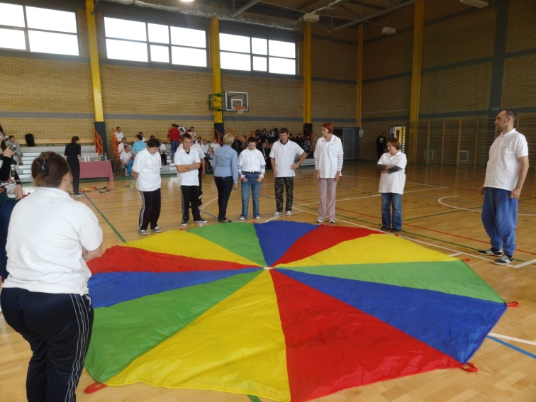
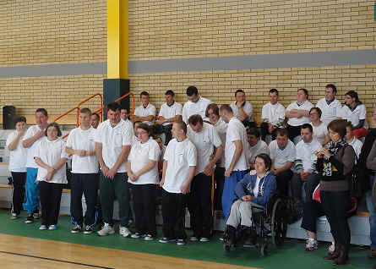
People with disabilities
We organize some sports and cultural events

Slide 12
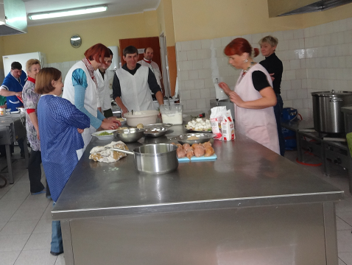
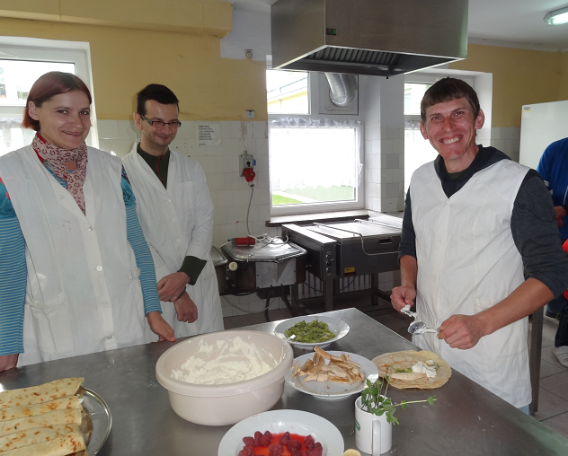
People with disabilities
Culinary activities

Slide 13
SENIORS and unemployed
University of the Third Age
lectures
culinary classes
ICT courses
sports and dance activities
study visits

Slide 14
Thanks for your
patience
☺

