Slide 1
GAMA Foundation
LIFELONG LEARNING PROGRAMME
LEONARDO LEARNING PARTNERSHIPS
Project’s title: CULINARY BRIDGES ACROSS EUROPE
SECOND WORKING MEETING IN NICOSIA, CYPRUS
MARCH 2014

Slide 2
WHERE ARE WE FROM

Slide 3
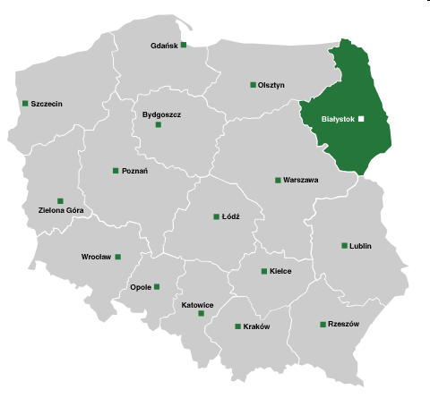
Podlaskie VOIVODSHIP (REGION)
←

Slide 4
Podlaskie VOIVODSHIP (REGION)
The Podlaskie Voivodship lies in the north-eastern part of our country, just next to the borders with Lithuania and Belarus.
Here, the civilizing progress of our times is constantly losing its battle with nature which lies protected in four national parks and three natural parks.

Slide 5
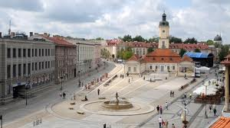
Podlaskie VOIVODSHIP (REGION)
Bialystok with 300 thousand inhabitants is the biggest town in the region and its capital.

Slide 6
Podlaskie VOIVODSHIP (REGION)
It is a region of many cultures, where for centuries in peace live representatives of many religions.
Polish Catholics, the Orthodox Church with Belarusian origins and the descendants of Tatars live together in the villages lost in the Knyszynski Forest. The crosses of churches, domes of Orthodox churches and half moons of mosques can be seen on the roofs of their wooden houses.
Of great importance and very popular in this Voivodship is the Bialowieska Forest, the last natural lowland forest in Europe.

Slide 7
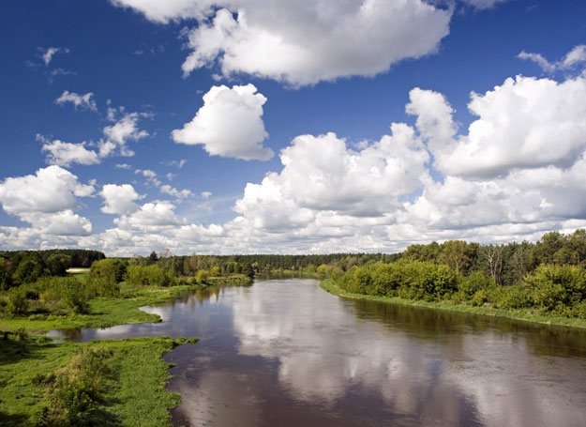
Podlaskie - land of rivers, lakes …

Slide 8
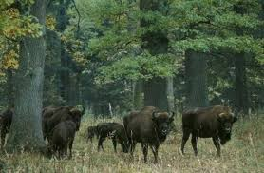
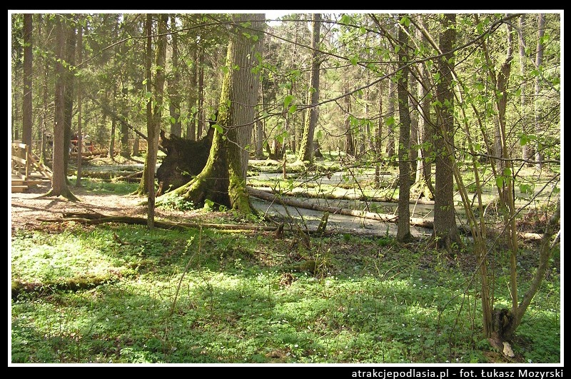
and old forest

Slide 9
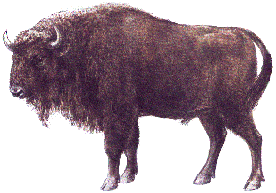
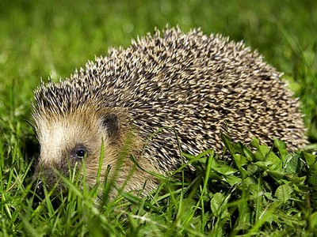
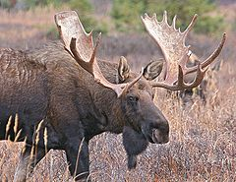
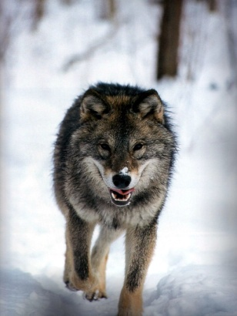
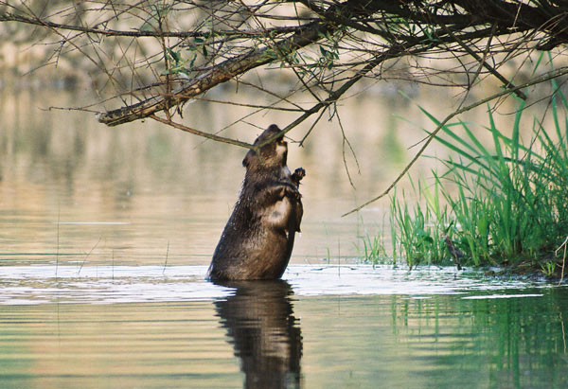
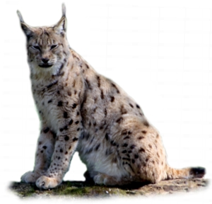
Some animals
This province is a the mainstay of wild animals and plants on the scale of Polish and Europe.

Slide 10
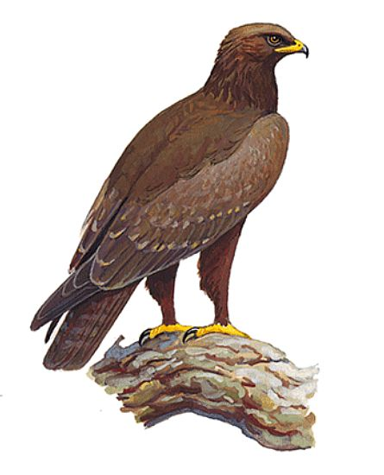
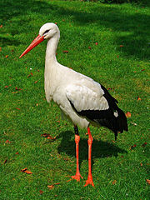
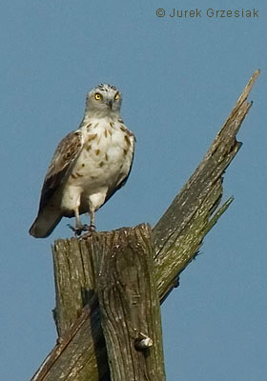
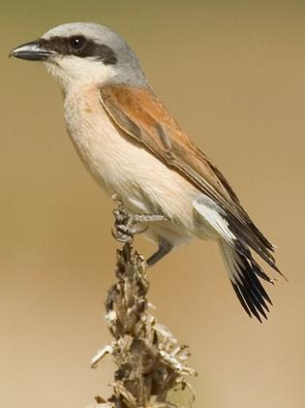
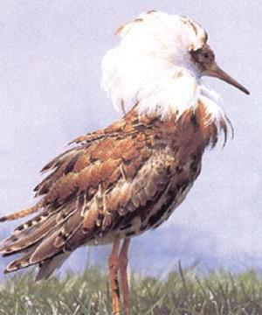
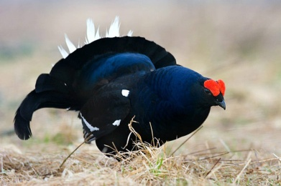
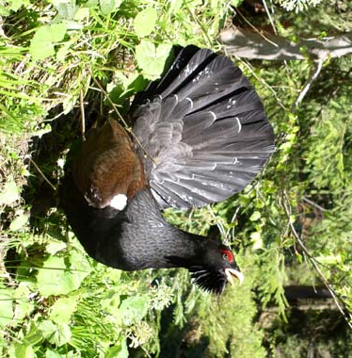
some Birds

Slide 11
DĄBROWA BIAŁOSTOCKA
The municipality is located in the buffer zone of the Biebrzanski National Park (natural scenic area of a primary character, the largest in this part of Europe).
The area is surrounded by picturesque lands covered with swamps and bogs which extend within 1000 km2 and are partly included in area of Dabrowa Bialostocka

Slide 12
What is eaten in the Podlasie region?
The Podlasie cusine dominate mushrooms, forest fruits, potato dishes, cereal, tree pie, and hard drinks and liquor.
Podlasie region is extremely rich, varied cuisine influences Lithuanian, Belorussian, Tatar, and even of the West Ukraine.

Slide 13
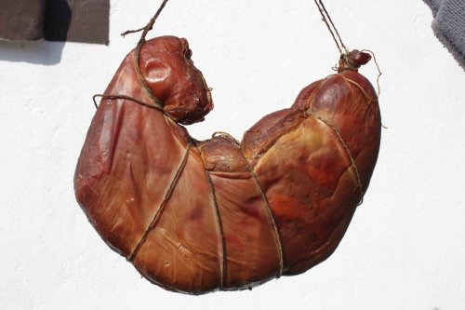
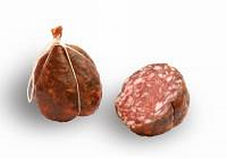
Podlaskie tastiest dishes
Kindziuk - sausage traditionally kneaded the Suwalki region, whose name comes from the Lithuanian language.

Slide 14
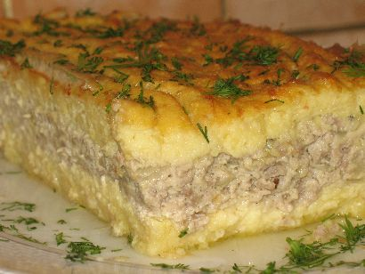
Podlaskie tastiest dishes
Babka - potato dish with a unique flavor.

Slide 15
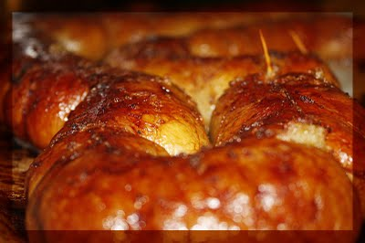
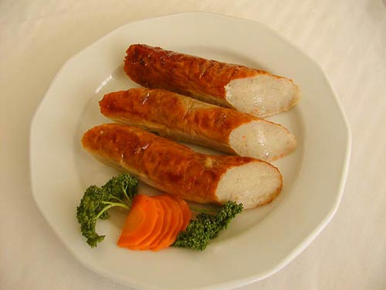
Podlaskie tastiest dishes
Potato sausage – characteristic dish commonly prepared only in Podlasie.

Slide 16
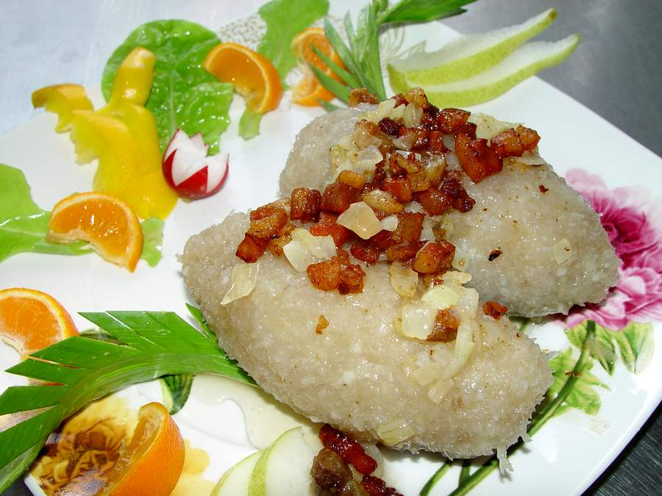
Podlaskie tastiest dishes
Kartacze - made from potato in a variation of Podlasie.

Slide 17
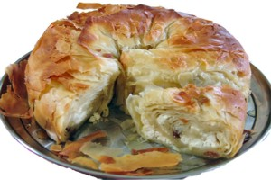
Podlaskie tastiest dishes
Pierekaczewnik - stacked layers of dough, which can be stuffed with cheese, apples or meat.

Slide 18
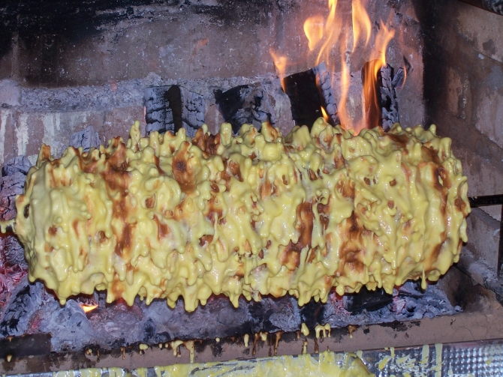
Podlaskie tastiest dishes

Slide 19
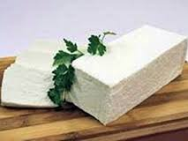
Podlaskie tastiest dishes
Twaróg – white cheese.

Slide 20
Podlaskie tastiest dishes
The Podlasie Year Brand, Poland Now competition and Our culinary heritage as well as AgroEco Turism Fair in Augustów are prestigiouse plebiscites that promote the tastes of Podlasie.
The winner dishes from Sokolski district include the Korycin`s cheese, Podlaski kindziuk sausage, bread with apples and klinek curd cheese.

Slide 21
Podlaskie tastiest dishes
In summer very popular culinary outdoor events are held:
National Strawberry Days
Cheese holiday in Korycin
Tatar Sabantuj holiday in Kruszyniany
Apart from this, special types of honey produced in the local bee yards are very popular among gourmets.

Slide 22
Thanks for your
patience
☺

